Slide 1


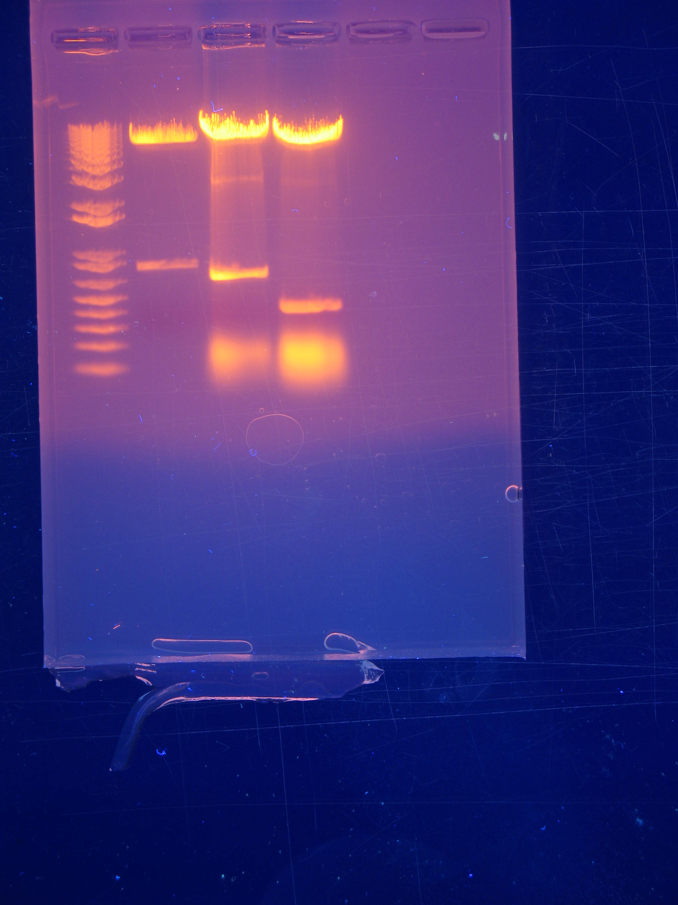
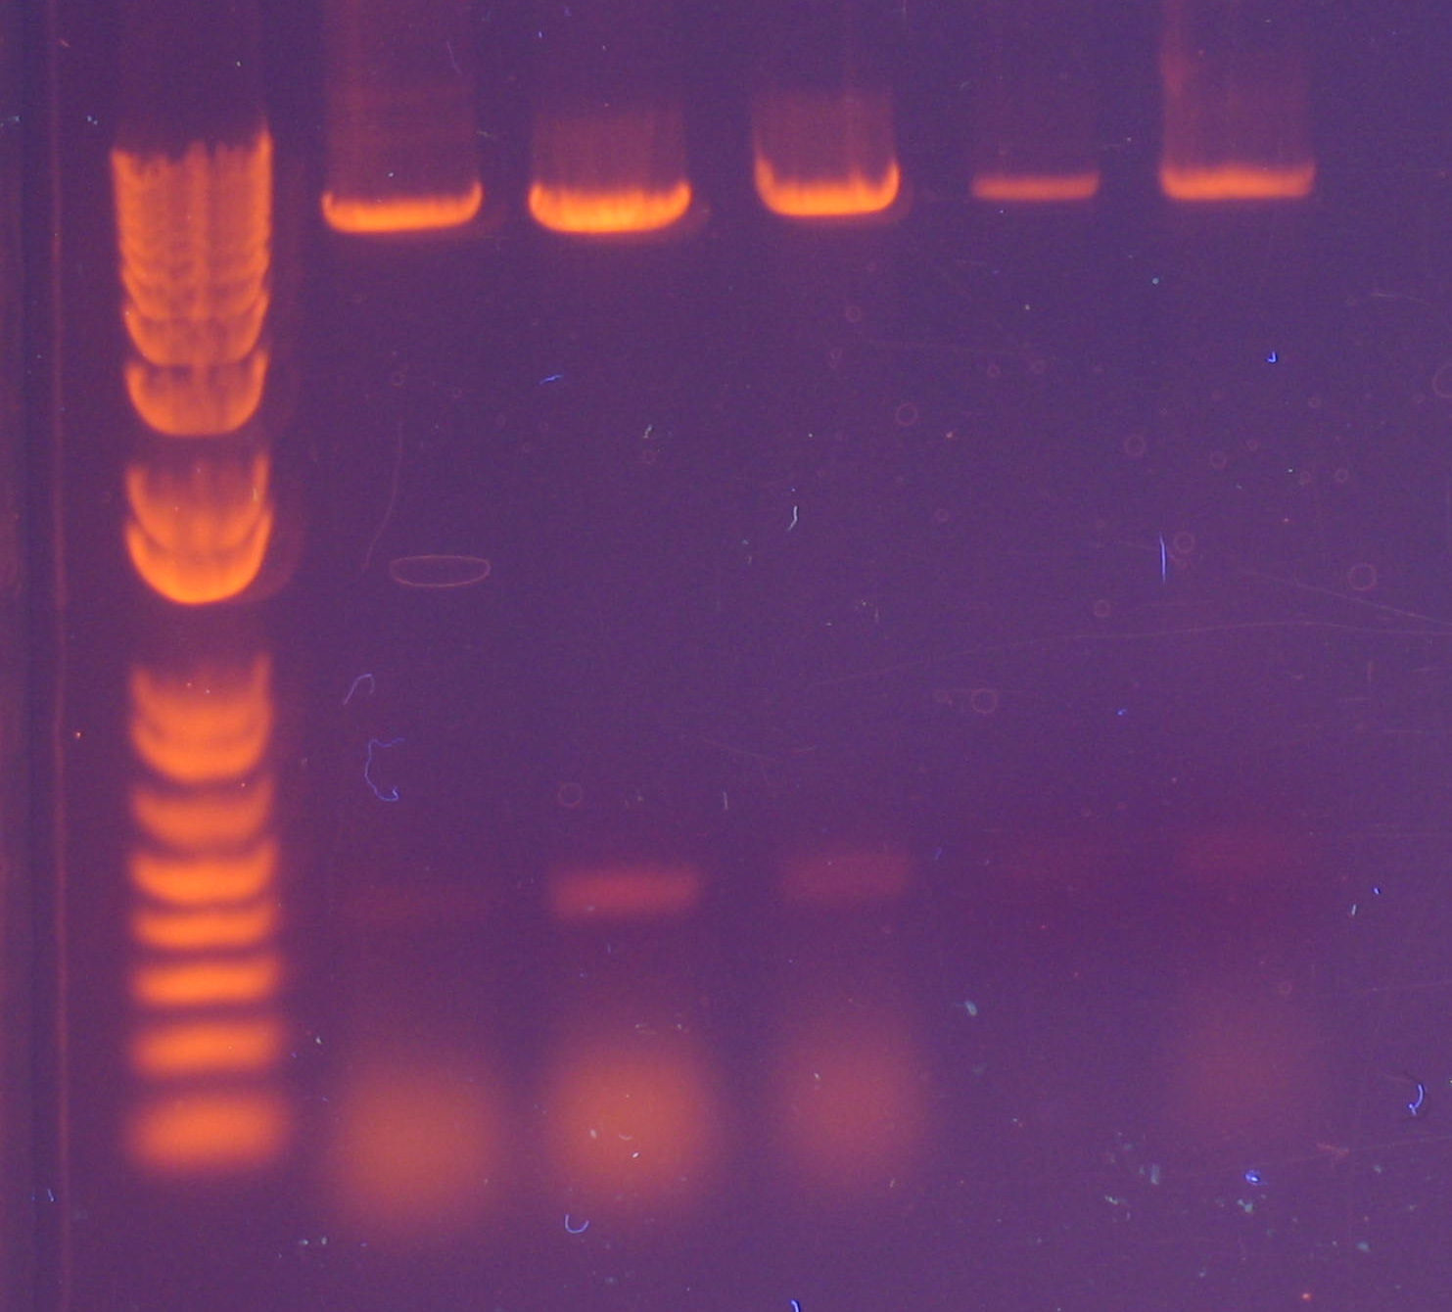
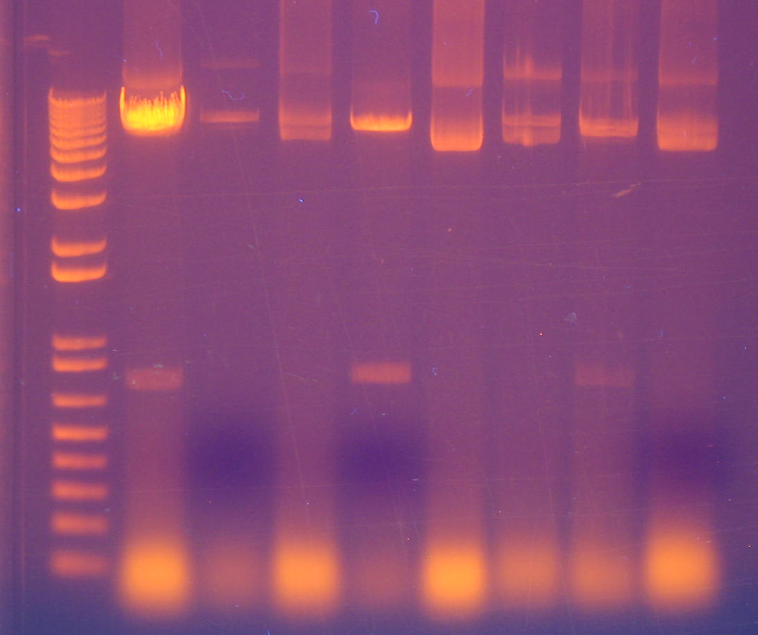
Exchanging of selection markers in pLKO.1 DNA plasmids through cloning technique
Dylan B. Siegler, Brittany E. Aguila and Scott M. Welford
Case Western Reserve University, School of Medicine
University School
Background
Process of Molecular Cloning
Results
The technique of cloning plasmids provides scientists the opportunity to study the effects of proteins and pathways in various organisms by easily modifying or changing the expression of a target. The process of cloning includes DNA isolation followed by ligation and E.coli competent cell transformation. Cloning a plasmid, a circular piece of DNA that is separate from the chromosomal DNA, is used for the purpose of transferring genetic information into another organism. The organism will then use its own mechanisms to express the inserted plasmid. After the plasmid is expressed, this expression can be further studied to understand gene function, investigate promoters, small RNAs, and other genetic elements. Within each plasmid, there are selection markers that allow for the presence of the plasmid to be recognized both during the cloning process and for techniques downstream of cloning. Common selection markers include ampicillin, puromycin, and blasticidin; all three are antibiotics. The presence of an ampicillin resistance gene within the plasmid allows for the scientist to select for E. coli competent cells that contain the desired plasmid after the transformation. Cells that lack the desired plasmid will not grow in media containing ampicillin. Puromycin and blasticidin act similarly to ampicillin; they will also only allow cells, both eukaryotic and prokaryotic, with a plasmid containing the puromycin or blasticidin resistance gene to continue to proliferate in the cell culture media.
We have successfully cloned multiple plasmids to now contain a selectable marker of blasticidin instead of puromycin. Upon diagnostic analysis, the correct plasmids will have a band around 6500 base pairs and another band around 400 base pairs in size. Diagnostic analysis of colonies that produces a smear on the gel or does not have a band around 400 base pairs is incorrect.
pLKO.1-shRNA-puro
pLKO.1-blast
1 Kb Plus Ladder
Plasmid 1
Plasmid 2
Plasmid 3
Gel electrophoresis on the digestion samples. We cut out the 2 parental vectors as well as the insert and proceeded to ligate them together.
Parental vectors
Restriction enzyme digest
Insert (blasticidin)
Goals
Our goal was to successfully change the antibiotic selection marker from puromycin to blasticidin in pLKO.1 DNA plasmids.
Ligation
1 Kb Plus Ladder
Vector 3
1 Kb Plus Ladder
Vector 2
Vector 1
Vector 5
Vector 4
Vector 4
Vector 5
Vector 7
Vector 2
Vector 8
Vector 1
Vector 3
Vector 6
Materials and Methods
Band at ~6500 bp
In order to extract the parental vector from our plasmid we conducted a restriction enzyme digestion using specific restriction enzymes to target the appropriate sites on the plasmid. We used restriction enzymes KpnI and BamHI to remove the puromycin segment. We then performed gel electrophoresis on our digest reactions using a 1% agarose gel in order to separate the products. We cut out the top band from the gel, and we gel purified the sample in order to extract the parental vector without puromycin. These same steps were repeated in order to obtain the blasticidin segment from a different vector. We then proceeded to join the insert (blasticidin) and the parental vector via a ligation reaction. We also performed a vector-only ligation reaction as a negative control. The ligation reactions were then transformed into E. coli competent cells and plated on LB and ampicillin agar plates to be incubated overnight at 37°C. Colonies were selected and grown overnight in LB + ampicillin broth. We then extracted the DNA from the colonies by conducting a quick and dirty miniprep. To confirm that our ligation joined the correct two DNA segments, we digested the DNA extracted from individual colonies with restriction enzymes and performed a gel electrophoresis on the digestion products.
pLKO.1-shRNA-blast
Vector-only ligation
Transformation
Band at ~400 bp
E. Coli competent cells
A diagnostic gel of a successful ligation. The bands at ~6500 bp are the parental vector while the band at ~400 bp is the insert. The dimness of the bands at ~400 bp is likely due to low DNA concentration.
A diagnostic gel of an unsuccessful ligation. This gel contains incorrect sized bands.
Promoter
shRNA
BamHI
Blasticidin or puromycin
Grown out overnight
KpnI
A generalized vector map highlighting the relevant segments in a pLKO.1 plasmid containing shRNA.
pLKO.1 – shRNA
Conclusion
This work is still in progress as certain plasmids are more difficult to clone than others. These newly constructed plasmids will be used to produce lentivirus and infect cells in order to manipulate a particular gene expression in human cell lines.
Ampicillin

